Slide 1






Please click File > Make a Copy to save a copy of this presentation.
Introduction for Students

Slide 2
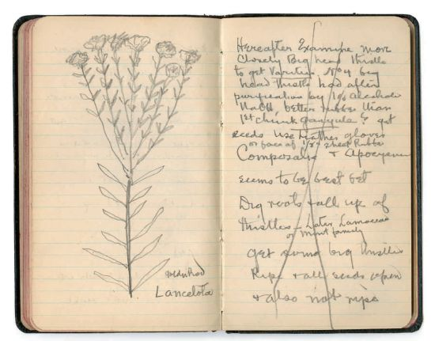
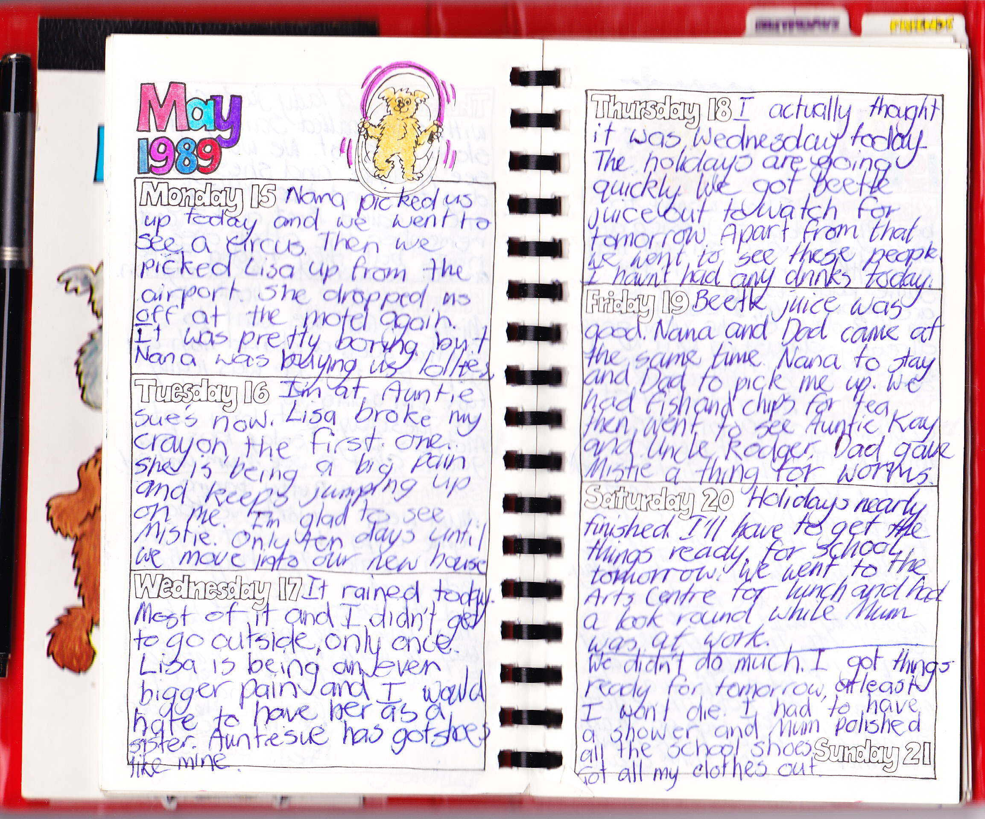


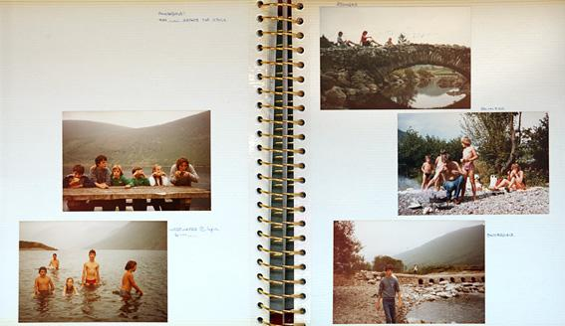
What is a journal?
It’s a place to record the news and events from your life.
Here are examples.
Blog
Notebook
Diary
Scrapbook
Family Photo Album

Slide 3
Why would I want to keep a journal?
To try and figure something out or help myself solve a problem
To help me remember things, especially details
To share something cool with other people
So I can look back to see what was great or what was difficult
So I have a place to be creative and brainstorm new ideas

Slide 4
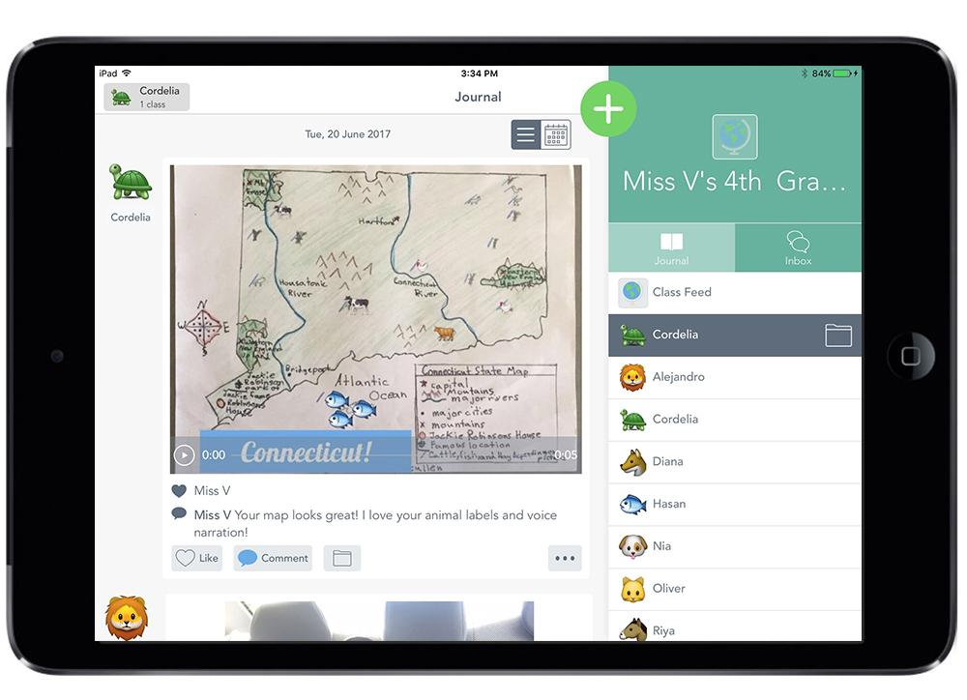

Let’s start keeping a journal!
Seesaw is a place where you can record all of the learning you’re doing at school and share it with your classmates, family and teachers.

Slide 5
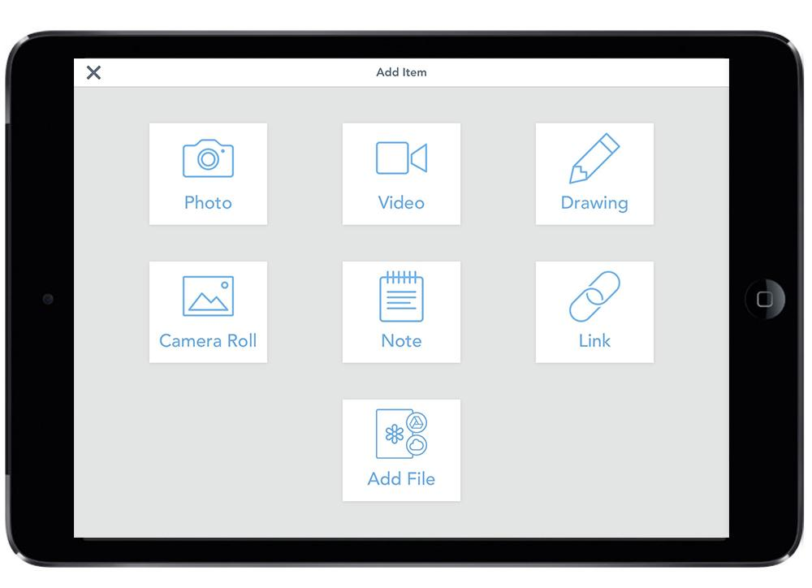
In your Seesaw journal you can ...
Take a photo or video, make a drawing, write a note, share a link or add something you’ve made in another app.

Slide 6
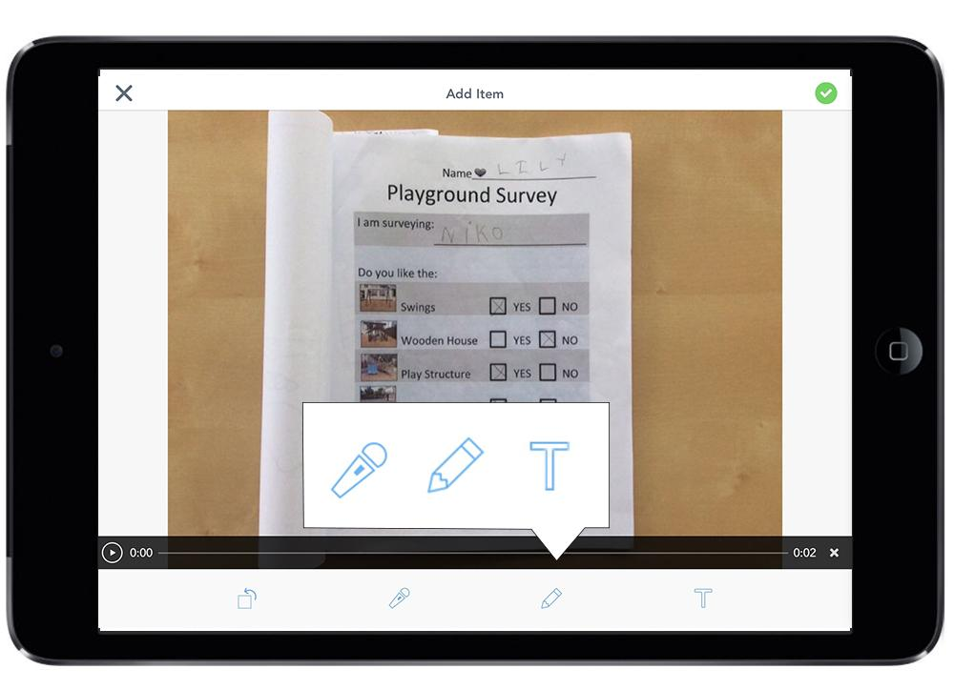
In your Seesaw journal you can ...
Add a voice recording, drawing or type a few sentences to explain something better or give more detail.

Slide 7
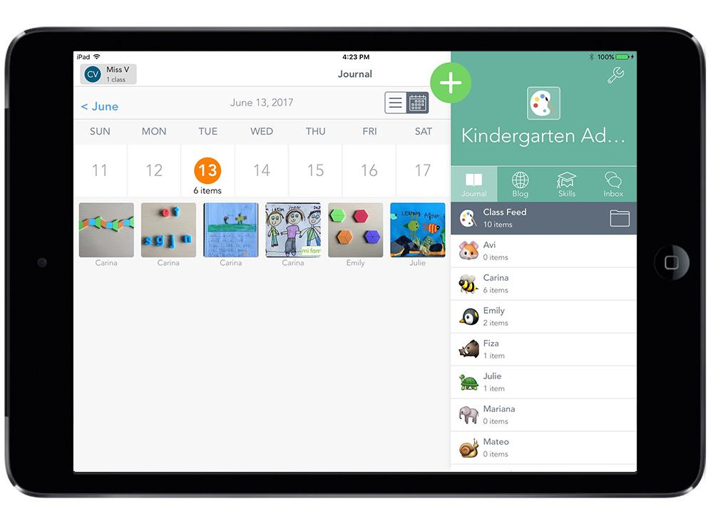
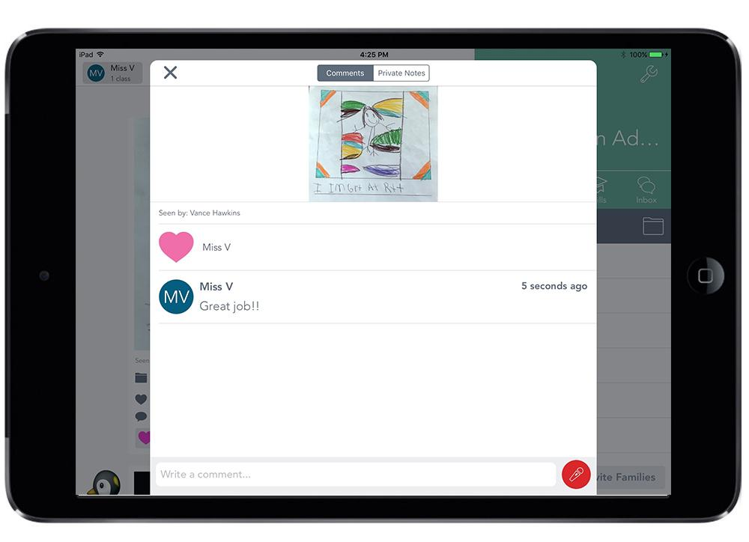
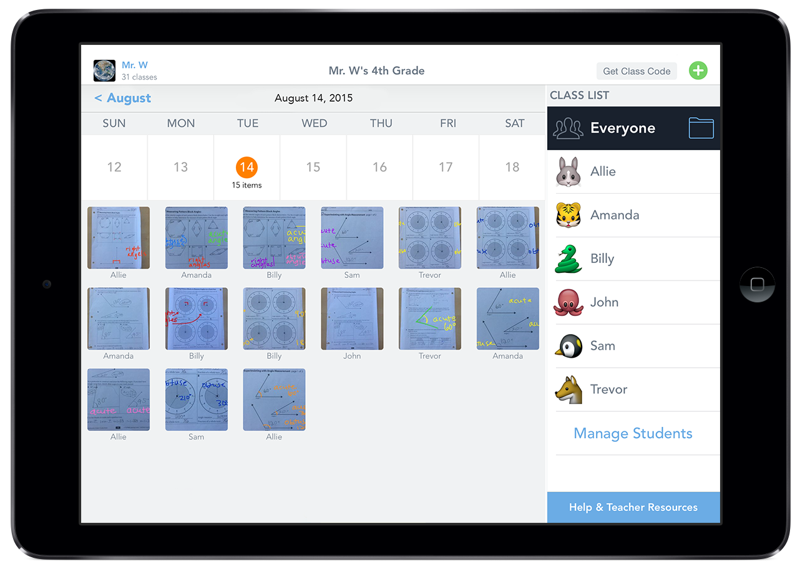
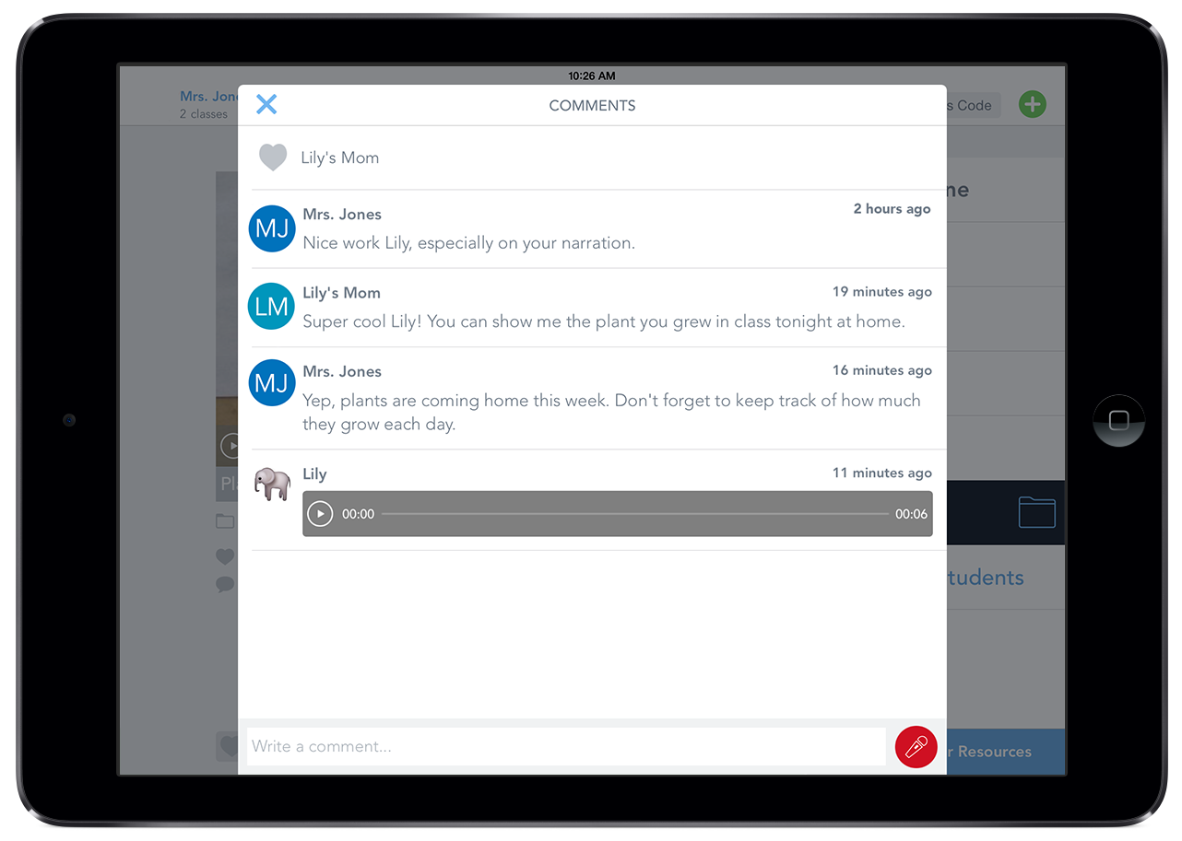
You also can ...
Look back at all of the cool things you’ve added to your journal and see how much you’ve learned.
Share the great stuff you’re learning and doing at school with your family.

Slide 8
What did you learn today that you want to add to your Seesaw journal and share?

Slide 9
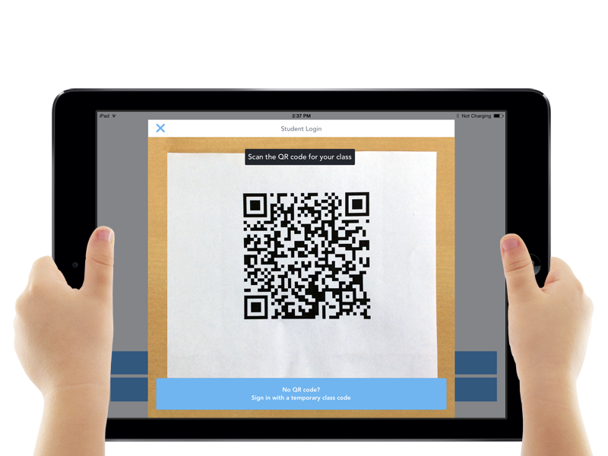
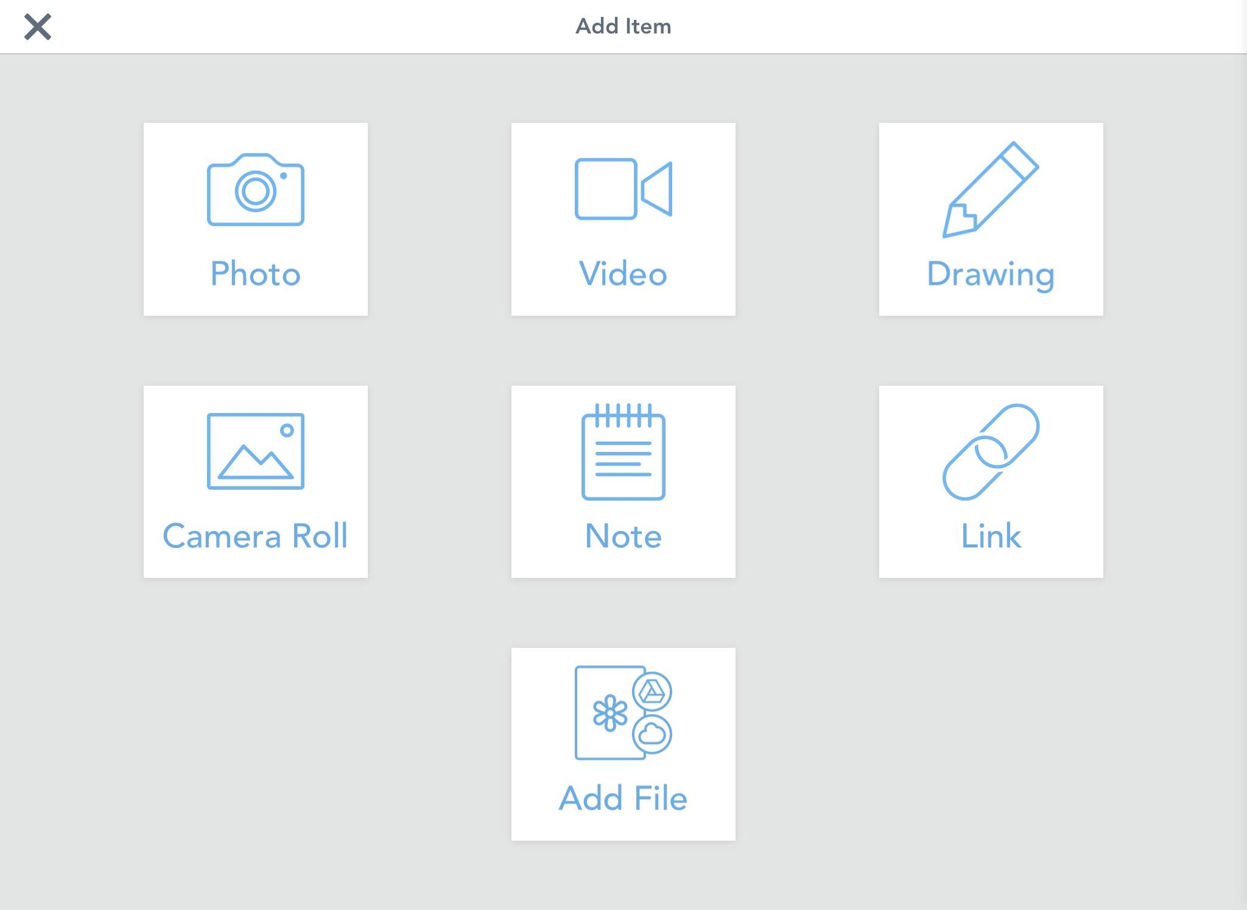
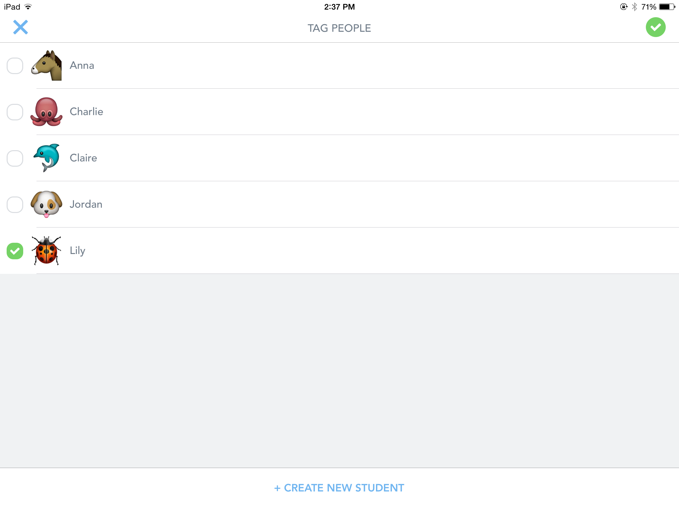
How to sign in with a class code
Tap the Seesaw app icon
Tap “I am a student” and scan the QR code or type the text code
Add something. Try taking a photo
Pick your name from the list to add to your journal
Notes:
You will show just one of these “sign in” slides to your students based on how you’ve set up your class and what tech setup you have. If you have a Class Code Class and shared iPads or Android devices, show this slide.

Slide 10


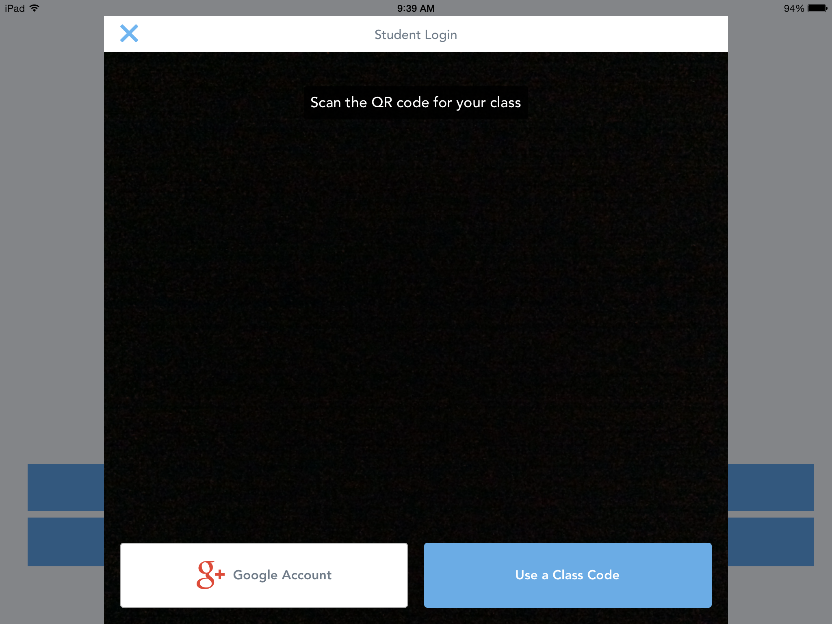
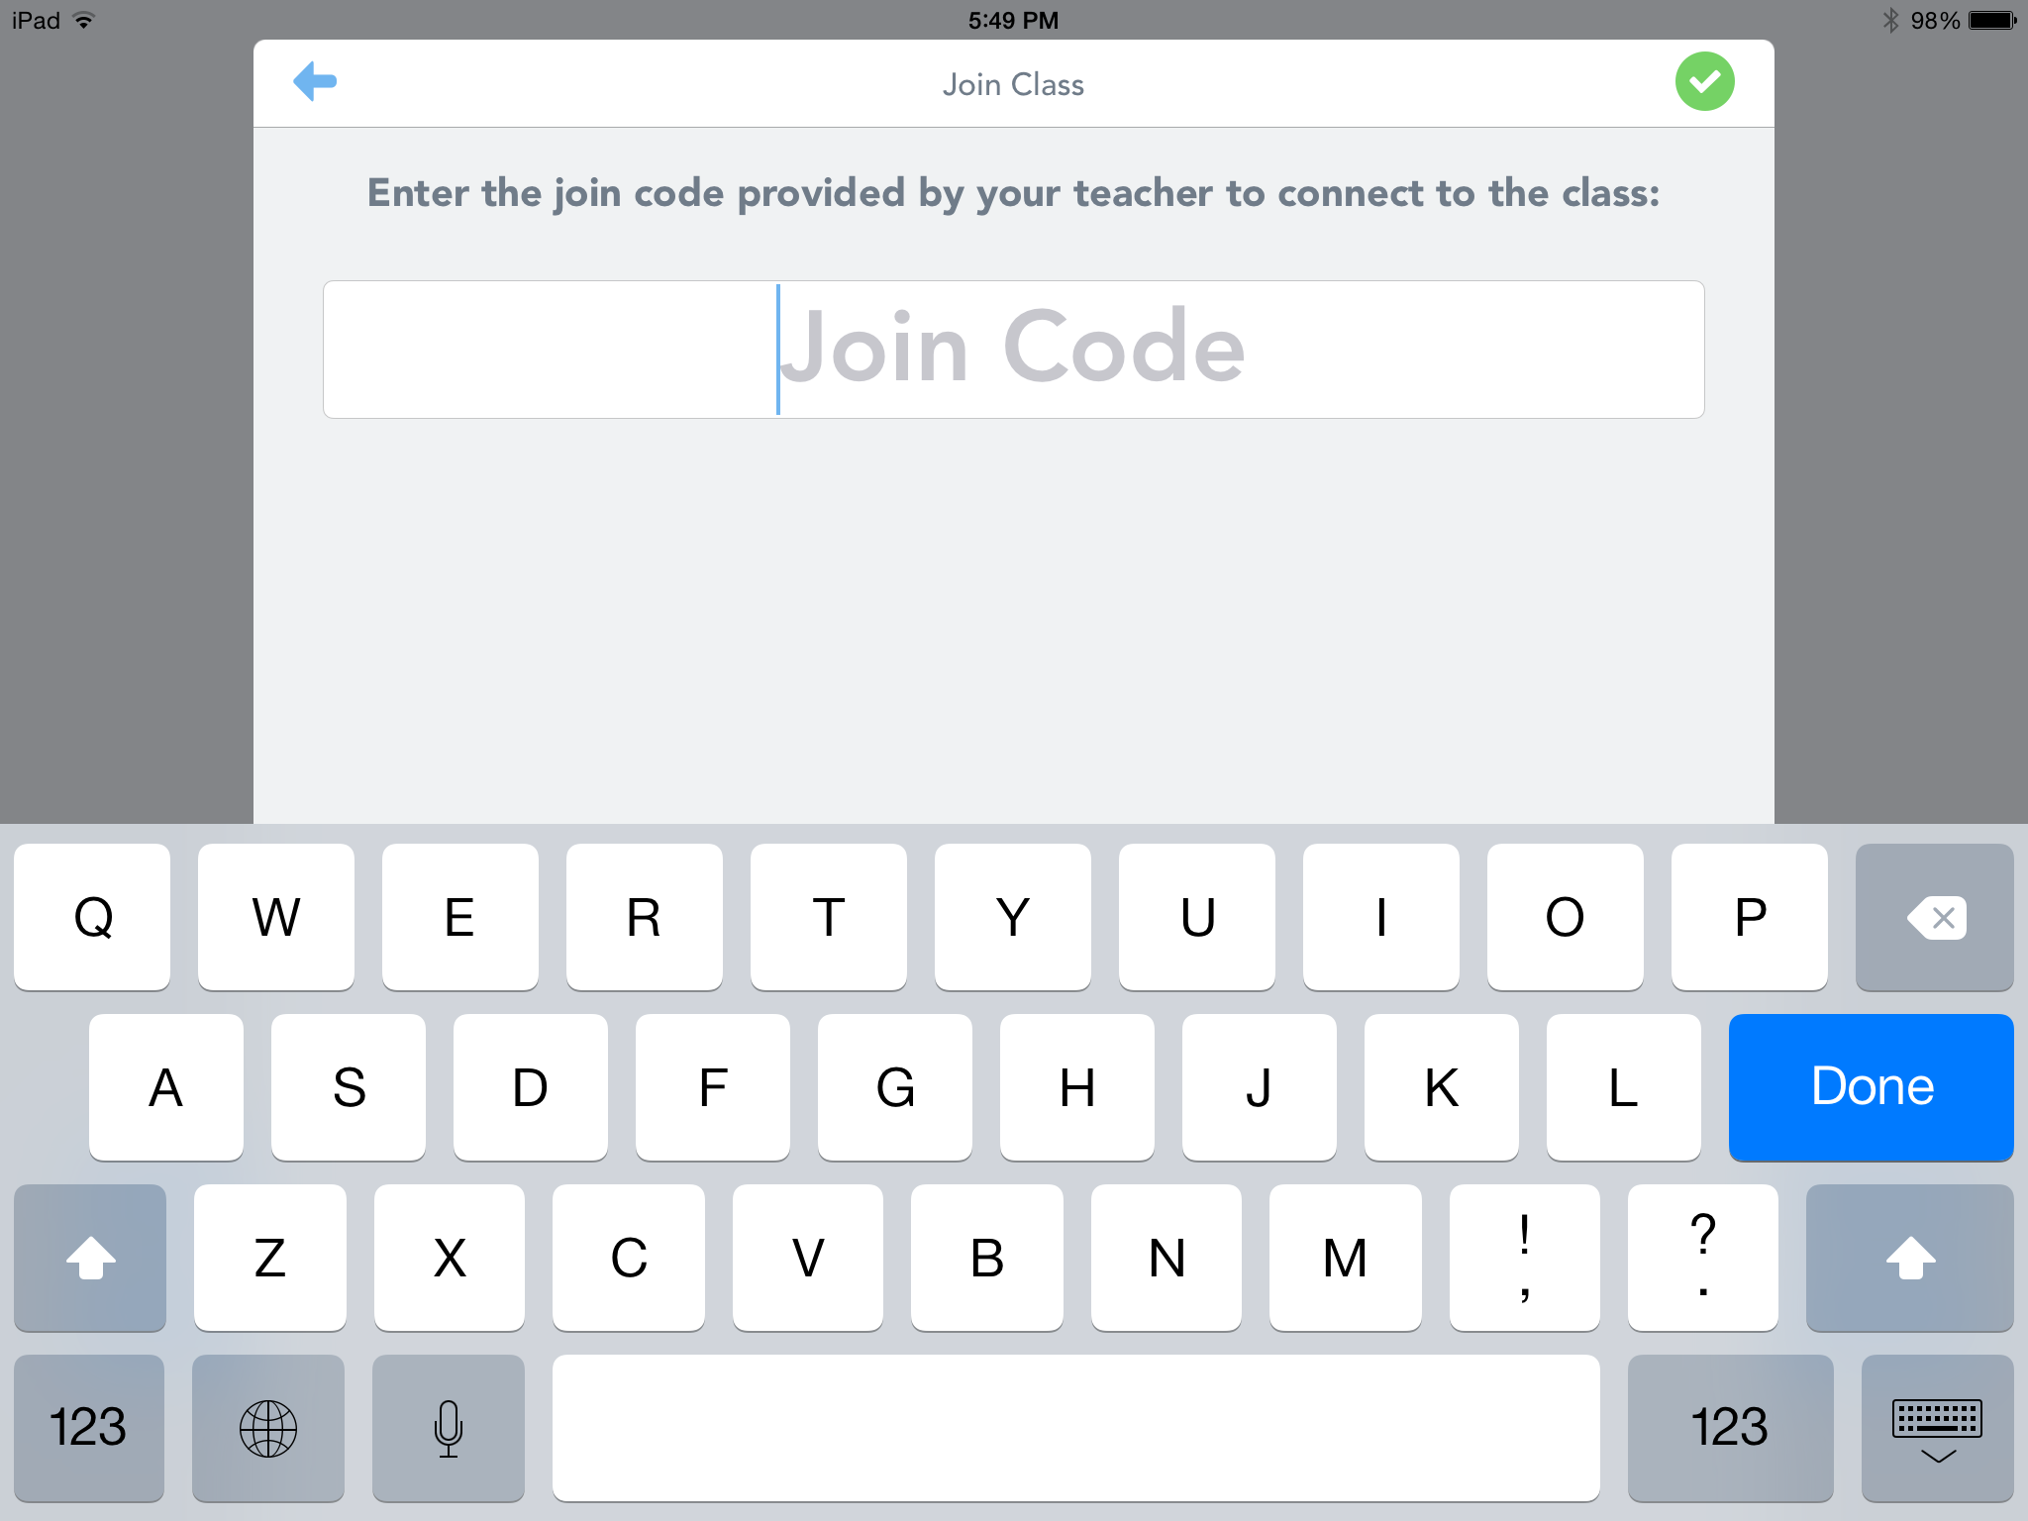
How to sign in with Email / Google Account
Tap the Seesaw app icon or go to app.seesaw.me on the web.
Choose “I am a student” and then Email/Google Account.
Choose New Student, and enter the join code from your teacher. You only need to join once.
Finish signing in and add your first entry. Try adding a photo!
Notes:
You will show just one of these “sign in” slides to your students based on how you’ve set up your class and what tech setup you have. If you have a Google Account Class and use iOS device, Android devices or computers, show this slide.

Slide 11
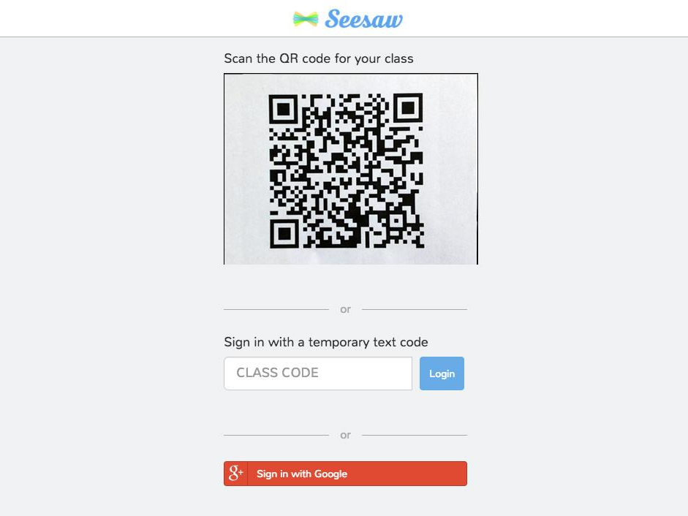
How to sign on the web
(with a Class Code)
Go to app.seesaw.me on Chrome or Firefox
Click “I am a student” and scan the QR code, type in the text code
Add something. Try making a drawing
Pick your name from the list to add to your journal
Notes:
You will show just one of these “sign in” slides to your students based on how you’ve set up your class and what tech setup you have. If you have a Class Code Class and computers, show this slide.

